Slide 1
Prototype Implementation
Amee Sankeshwara
Deepa Varghese
Devyani Shrivastava
Vinaya D Bhat

Slide 2
Data Model

Slide 3
Data Set: Freeway
NoSQL DB: MongoDB

Slide 4
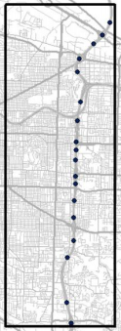
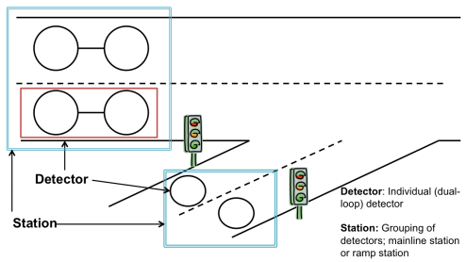
Freeway Dataset
Data set focuses on I-205 NB and SB;
A station is a set of related loop detectors.
A detector refers to a single dual-loop detector.
Loopdata contains 20-second speed, occupancy, volume and data quality flags for the freeway data.

Slide 5
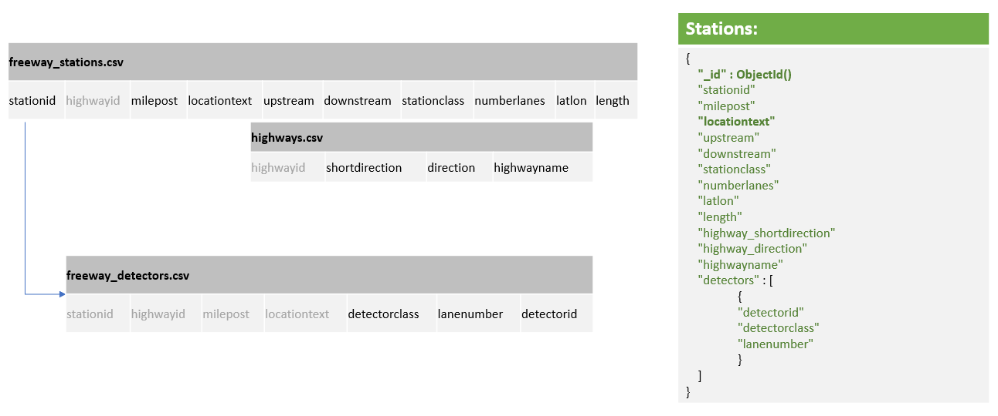
Collection: stations

Slide 6
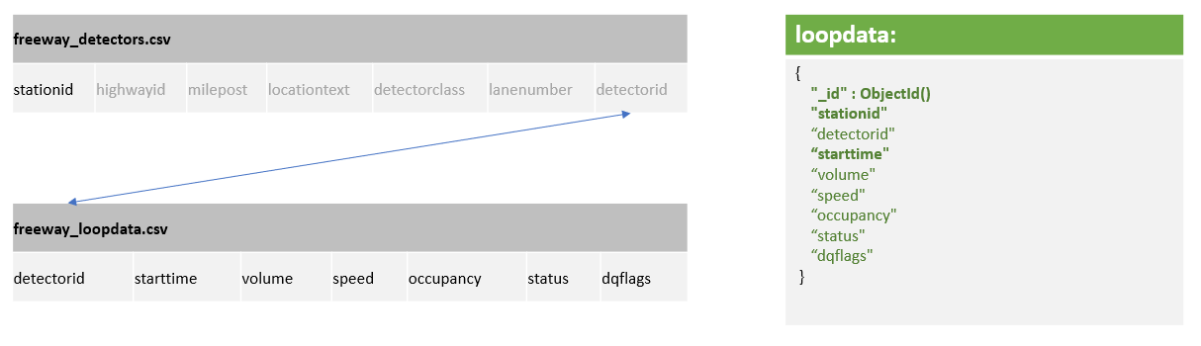
Collection: loopdata

Slide 7
Embedded Station documents with their respective list of detectorids, mainly because all the queries were for specific stations, so while fetching a station document, all the detectors that are a part of the station are also fetched along with it. Plus, redundancy of same data in multiple tables was avoided.
Added highway information in the Stations collection, risking redundancy, mainly because the chances of data related to highways getting update is too less. This redundancy allows for lookups to be avoided.
Freeway data is loaded as is, with addition to the related stationid, mainly for 2 reasons: 1) being a write-intensive table, we wanted to let the structure be as simple as possible 2) if we need to shard the data, we would do with stationid as the shard key

Slide 8
ETL from CSV files to collections in MongoDB: ETL between the csv files to MongoDB deployment in GCP was done using pymongo Mongoclient in python, where much of the datatype casting and Null values were handled.
Data has been cleaned for the following scenarios: 1) speed < 5 MPH 2) volume=0, speed>0
We’ve attempted all 6 questions for this dataset

Slide 9
Demonstration

Slide 10
Query - 3: Single-Day Station Travel Times: Find travel time for station Foster NB for 5-minute intervals for Sept 22, 2011. Report travel time in seconds.
Pseudo Code:
Get stations collection
Applying "locationtext"= "Foster NB" filter on find query.
Document{{_id=5de86eaebab763deb2af2349, downstream=1117, numberlanes=3, locationtext=Foster NB, milepost=18.1, upstream=1046, highwayname=I-205, highway_direction=NORTH, highway_shortdirection=N, latlon=45.478984,-122.565617, detectors=[Document{{detectorid=1361, lanenumber=1, detectorclass=1}}, Document{{detectorid=1362, lanenumber=2, detectorclass=1}}, Document{{detectorid=1363, lanenumber=3, detectorclass=1}}], length=1.6, stationclass=1, stationid=1047}}
Get station id and length from the document returned and store it in variables.
Get loopdata collection

Slide 11
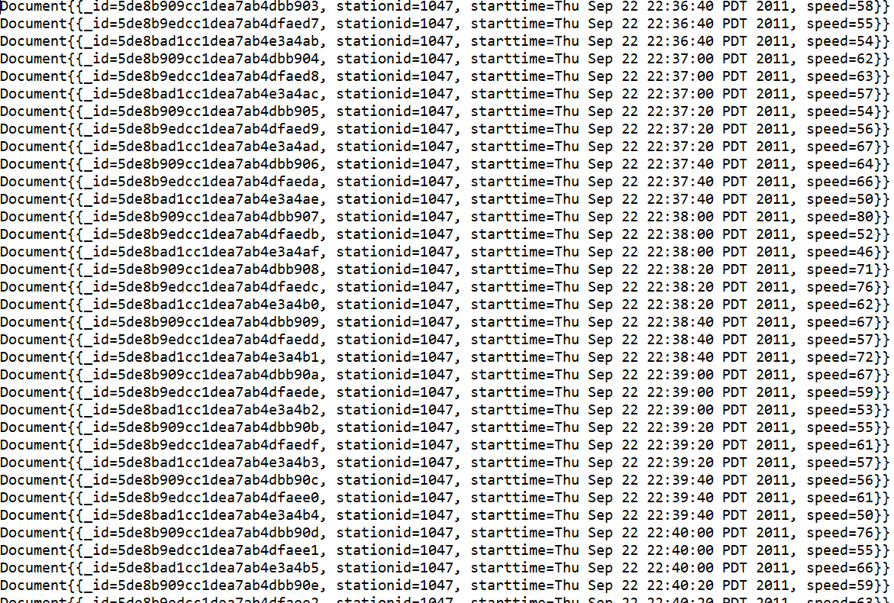
Query - 3: Single-Day Station Travel Times: Find travel time for station Foster NB for 5-minute intervals for Sept 22, 2011. Report travel time in seconds.
Aggregation pipeline stages on loopdata collection
Project only stationid, starttime and speed fields
Filter documents "stationid"= “Foster NB station id=1047”
Filter documents based on date (22nd Sept 2011).
Document{{_id=5de8b909cc1dea7ab4dbb903, stationid=1047, starttime=Thu Sep 22 22:36:40 PDT 2011, speed=58}}
Document{{_id=5de8b9edcc1dea7ab4dfaed7, stationid=1047, starttime=Thu Sep 22 22:36:40 PDT 2011, speed=55}}
Document{{_id=5de8bad1cc1dea7ab4e3a4ab, stationid=1047, starttime=Thu Sep 22 22:36:40 PDT 2011, speed=54}}
Document{{_id=5de8b909cc1dea7ab4dbb904, stationid=1047, starttime=Thu Sep 22 22:37:00 PDT 2011, speed=62}}
Document{{_id=5de8b9edcc1dea7ab4dfaed8, stationid=1047, starttime=Thu Sep 22 22:37:00 PDT 2011, speed=63}}
Document{{_id=5de8bad1cc1dea7ab4e3a4ac, stationid=1047, starttime=Thu Sep 22 22:37:00 PDT 2011, speed=57}}

Slide 12
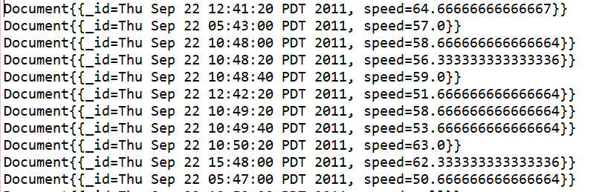
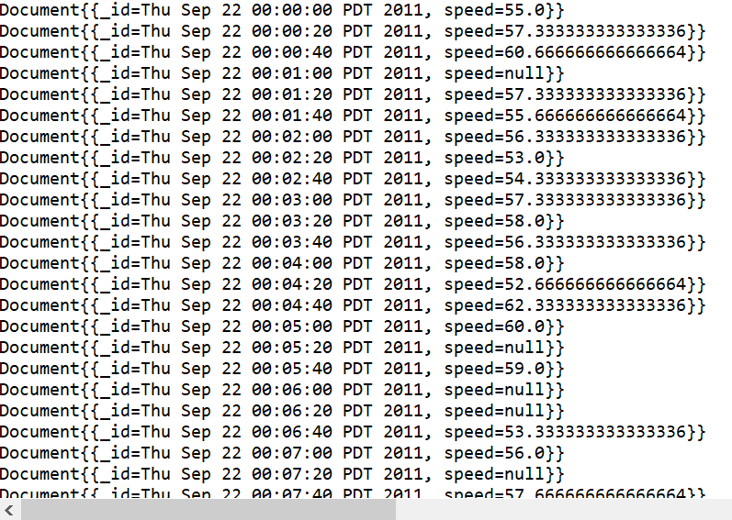
Query - 3: Single-Day Station Travel Times: Find travel time for station Foster NB for 5-minute intervals for Sept 22, 2011. Report travel time in seconds.
Aggregation pipeline stages on loopdata collection
Group documents on starttime and find average speed based on starttime
Sort the documents in ascending order based on _id field which is starttime

Slide 13
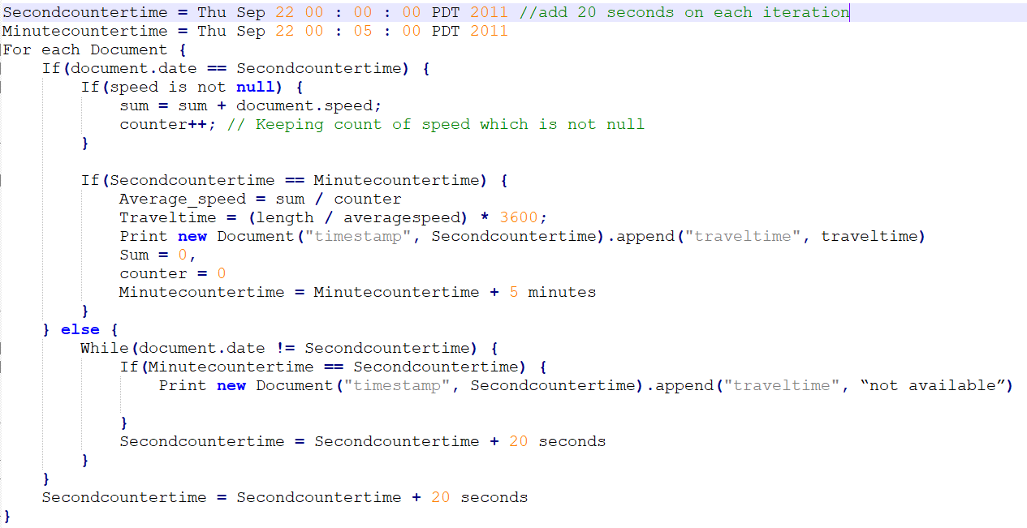
Query - 3: Single-Day Station Travel Times: Find travel time for station Foster NB for 5-minute intervals for Sept 22, 2011. Report travel time in seconds.
5 minute interval travel time calculation

Slide 14
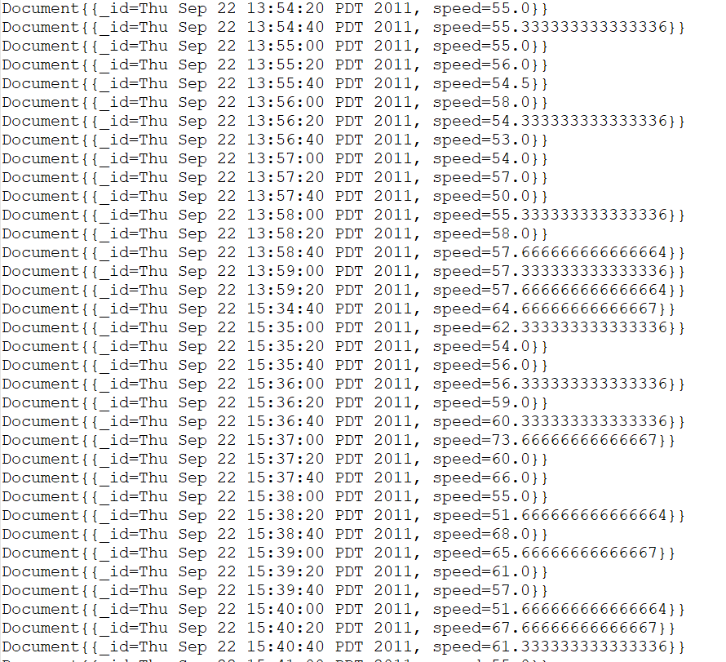
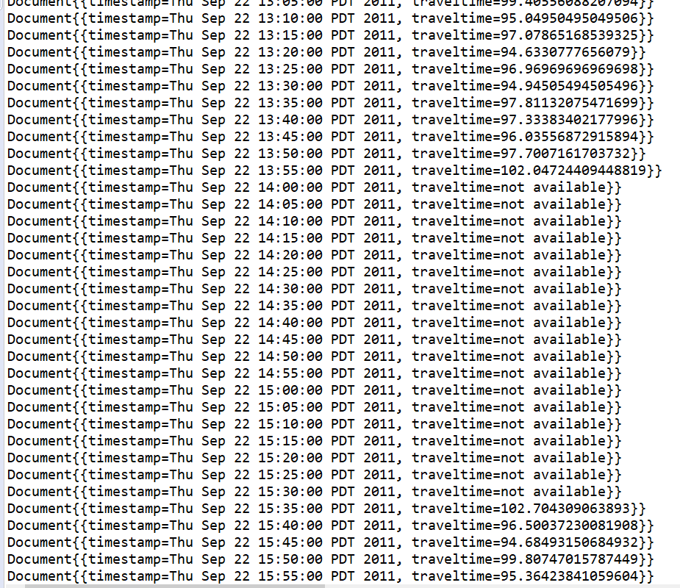
Query - 3: Single-Day Station Travel Times: Find travel time for station Foster NB for 5-minute intervals for Sept 22, 2011. Report travel time in seconds.

Slide 15
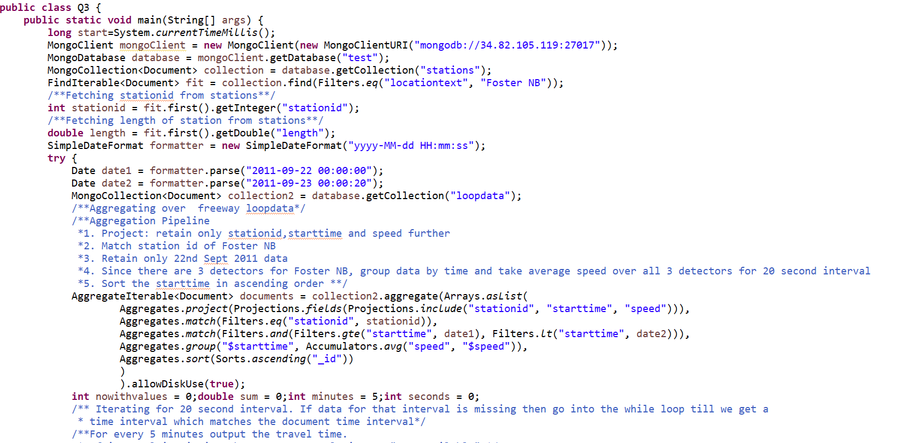
Query - 3: Single-Day Station Travel Times: Find travel time for station Foster NB for 5-minute intervals for Sept 22, 2011. Report travel time in seconds.

Slide 16
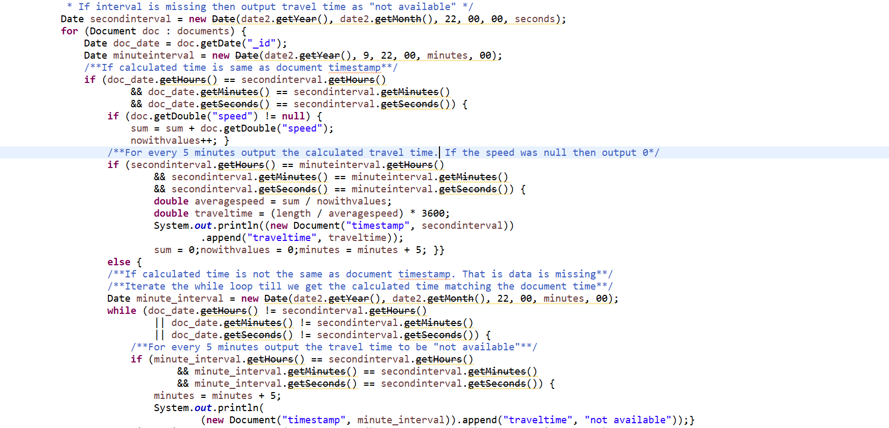

Slide 17
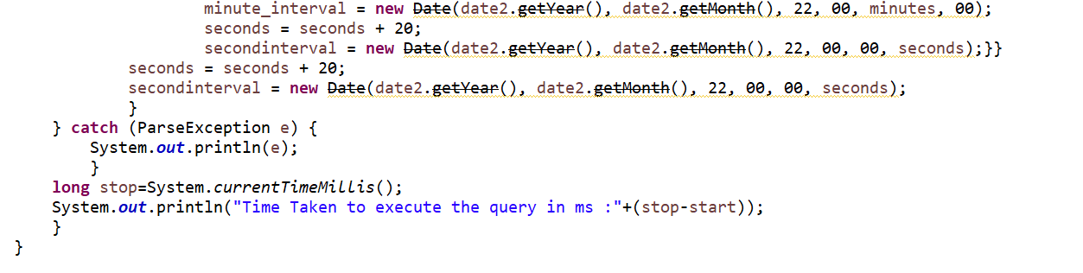
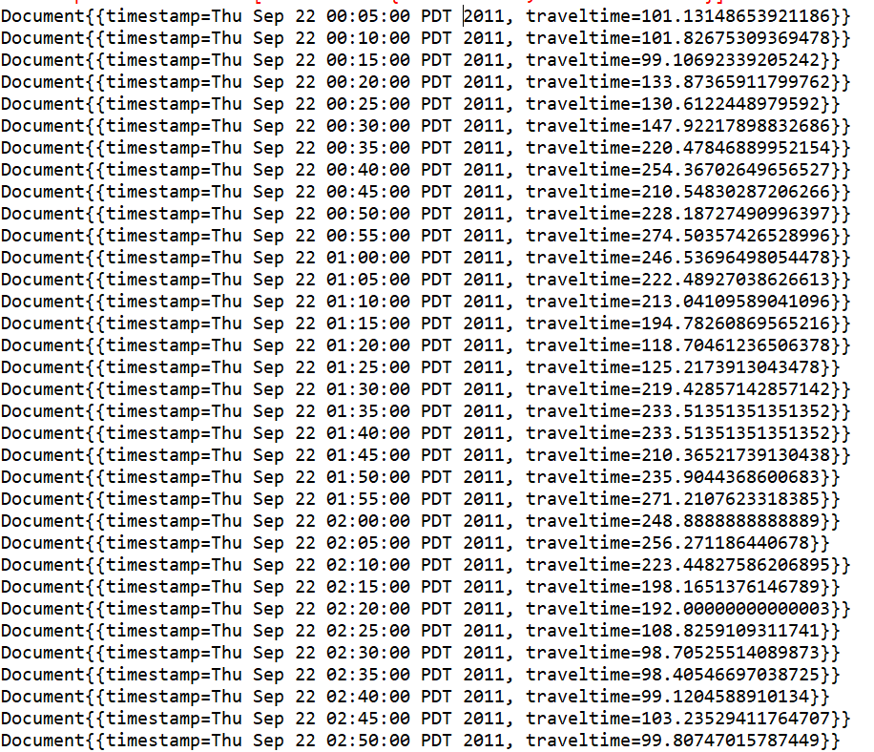

Slide 18
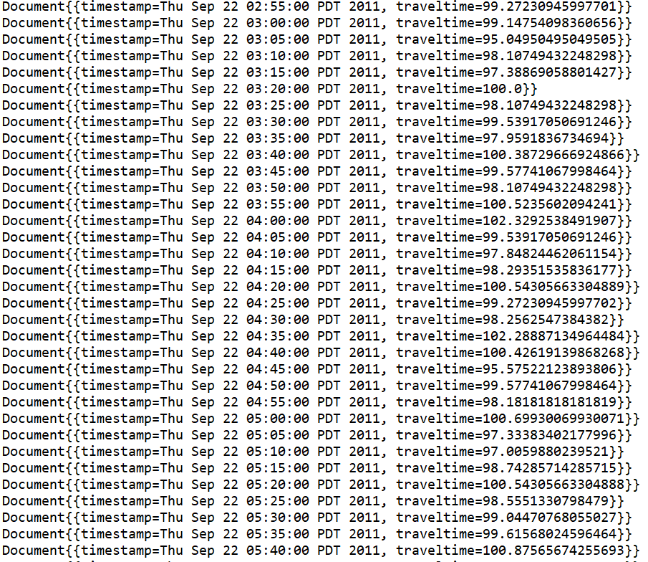
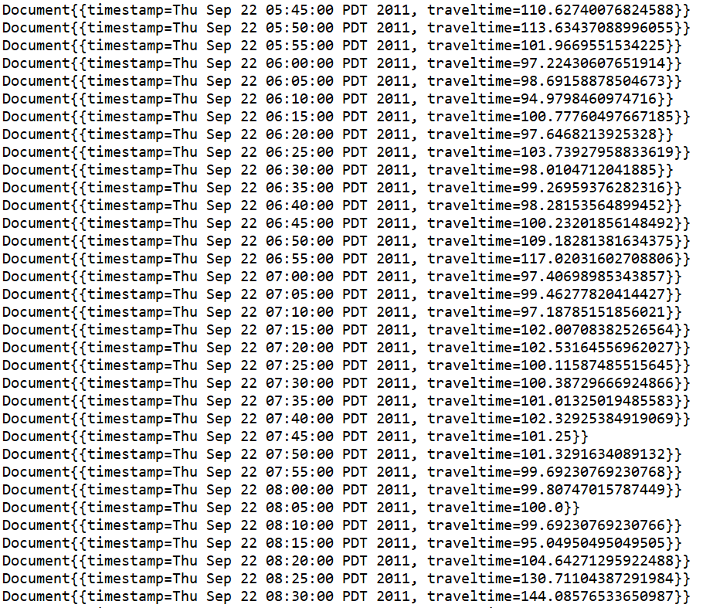

Slide 19
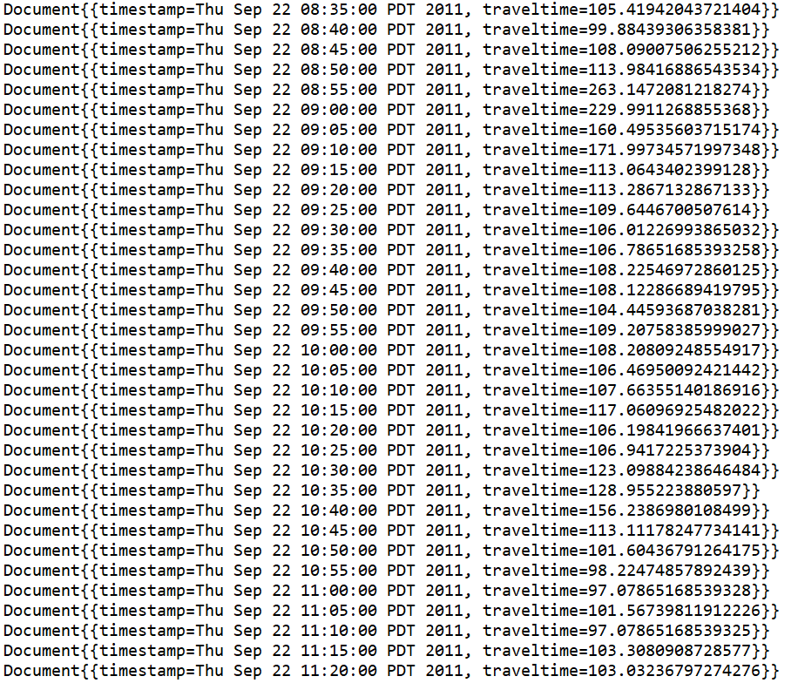
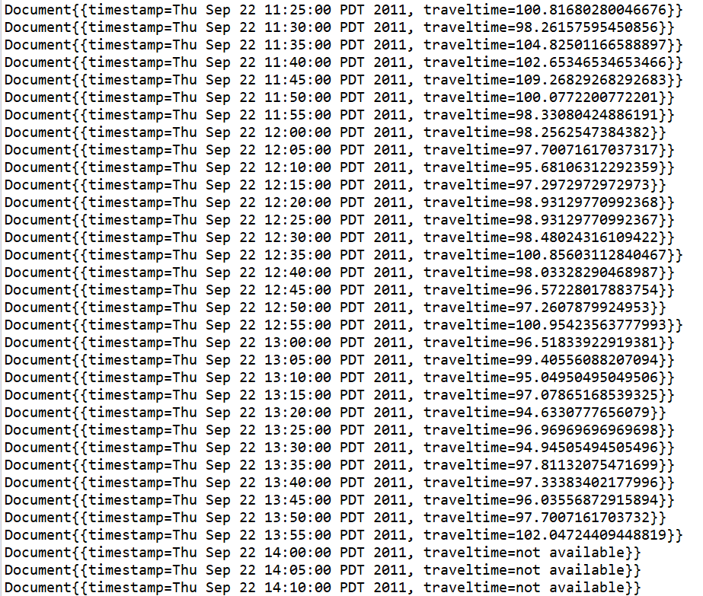

Slide 20
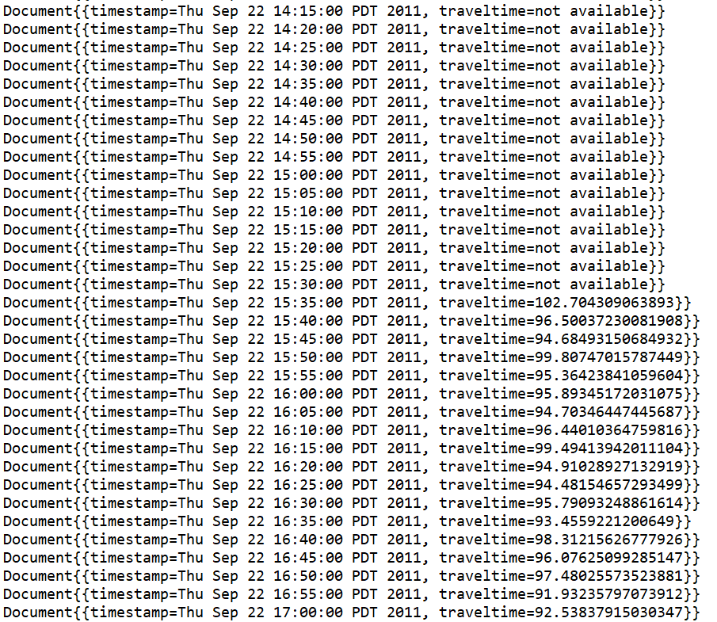
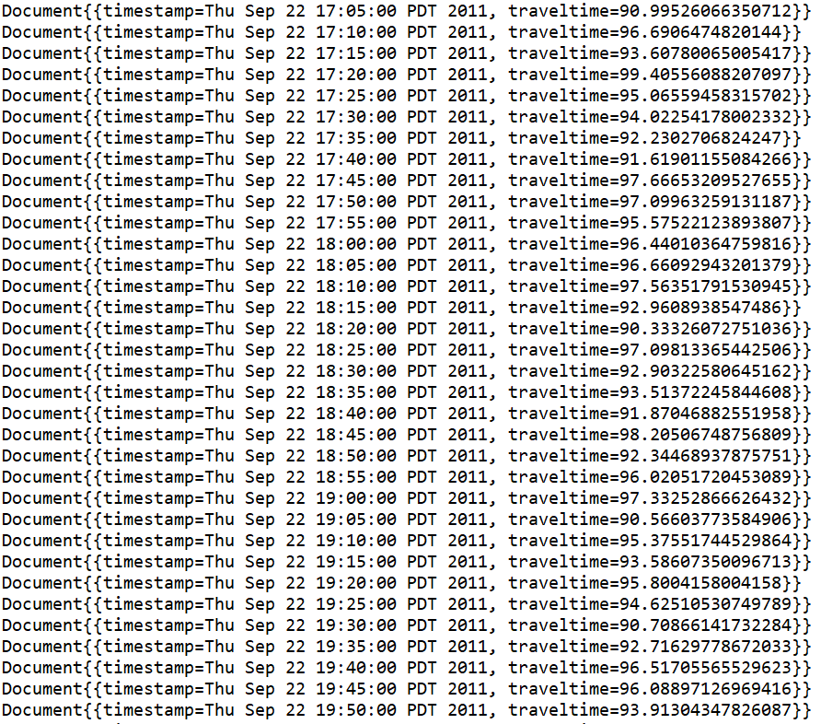

Slide 21
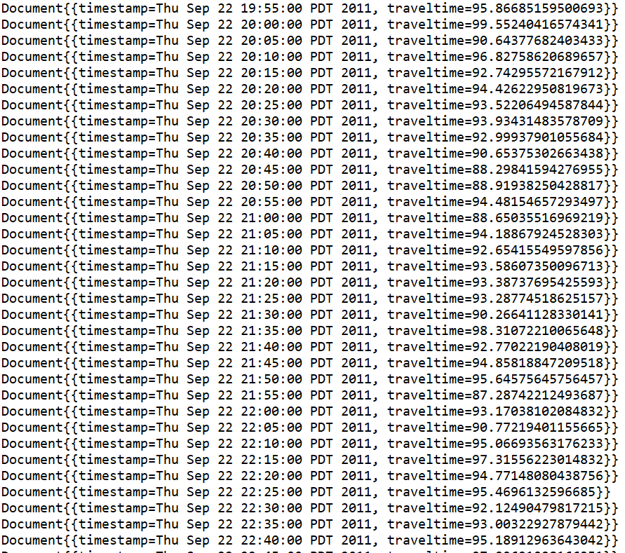
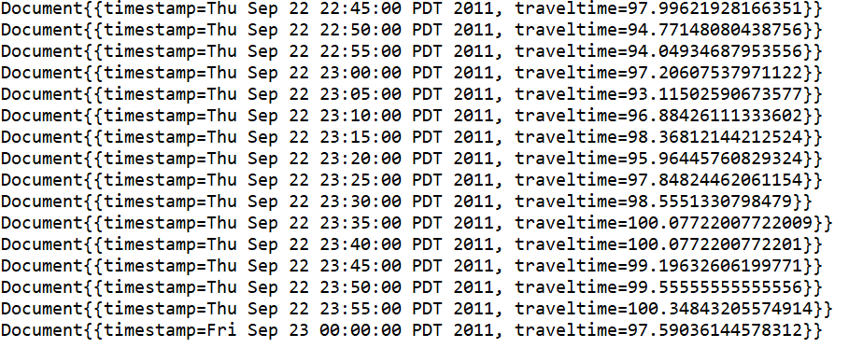

Slide 22
Query - 5 : Peak Period Travel Times: Find the average travel time for 7-9AM and 4-6PM on September 22, 2011 for the I-205 NB freeway. Report travel time in minutes.
Pseudo Code :
Get Collection stations.
Get Collection loopdata.
Applying filter highwayName=”I-205” and direction=”North” on Collection stations. And store result of all stations in new FindIterable(Set of document).
Declare one variable totalTravelTime to store final result.
Iterate using loop on set of document for each station.
Get station id and length from the set of document returned and store it in variables.
Aggregation pipeline stages for each station on loopdata collection
Project only stationid, starttime and speed fields
Filter documents “stationid”, which we have stored in variable.
Filter documents based on date (22nd Sept 2011) and time between 07:00 to 09:00 AM and 16:00 to 18:00 PM.
Group documents on starttime and find average speed based on starttime
Sort the documents in ascending order based on _id field which is starttime

Slide 23
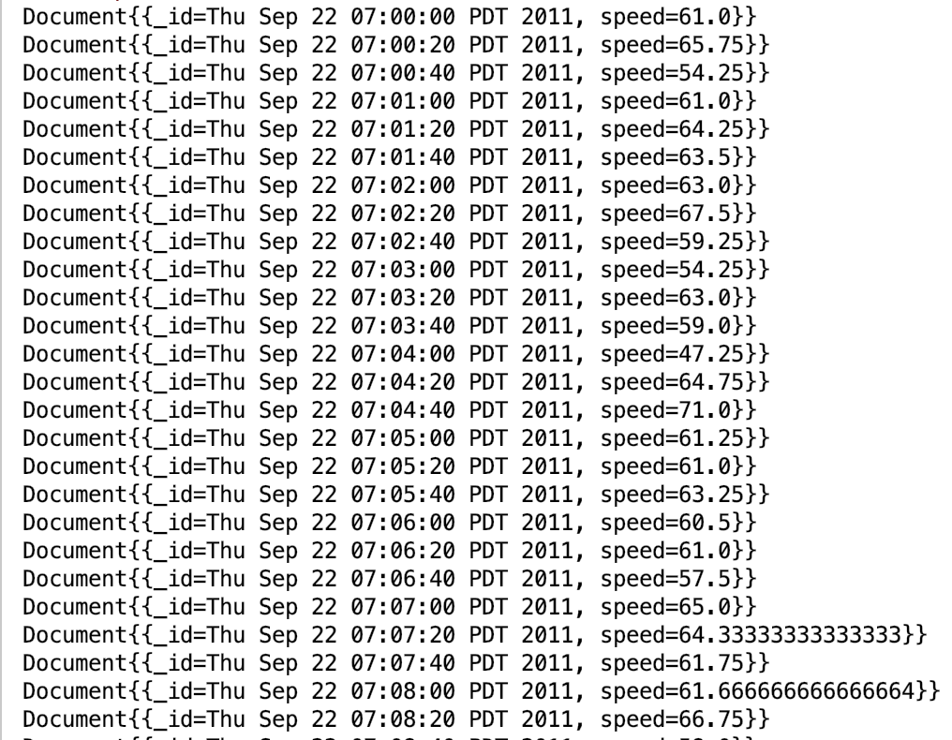

Slide 24
7. Calculate total speed and count for station by summing all speeds and count each row of set of document returned by aggregation pipeline.
8. Calculate average using total speed and count got in step-7 using below formula.
AvgSpeed = TotalSpeed/Count
9. Calculate travel time of station in minutes using length of station which we have stored in variable and AvgSpeed using below formula.
Traveltime = (length/AvgSpeed)*60;
10. Add travel time in totalTravelTime variable for each station like below to calculate total travel time of highway “I-205 NB”.
totalTravelTime=totalTravelTime+Traveltime
11. Out side loop print totalTravelTime.

Slide 25
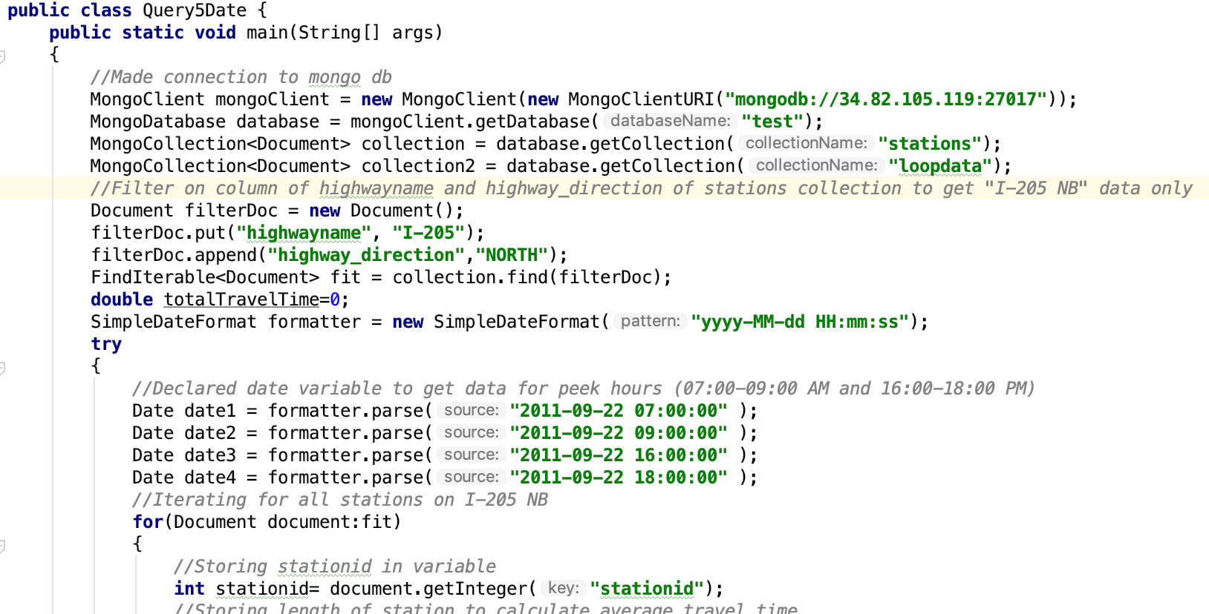
Query - 5 : Peak Period Travel Times: Find the average travel time for 7-9AM and 4-6PM on September 22, 2011 for the I-205 NB freeway. Report travel time in minutes.

Slide 26
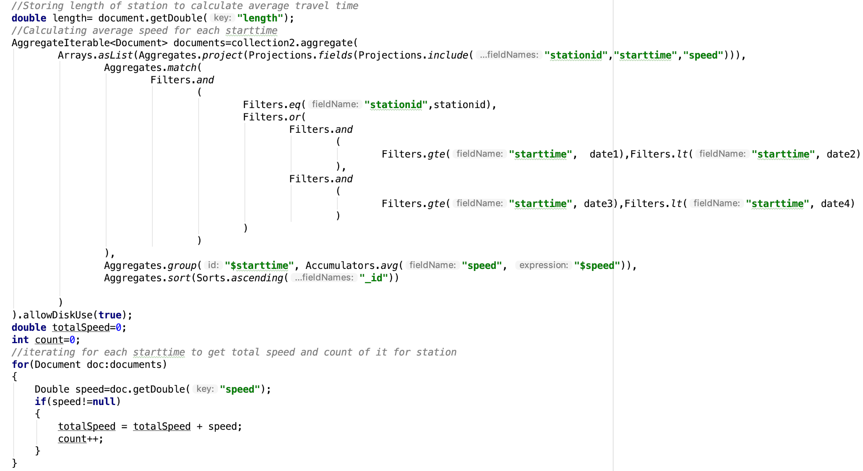

Slide 27
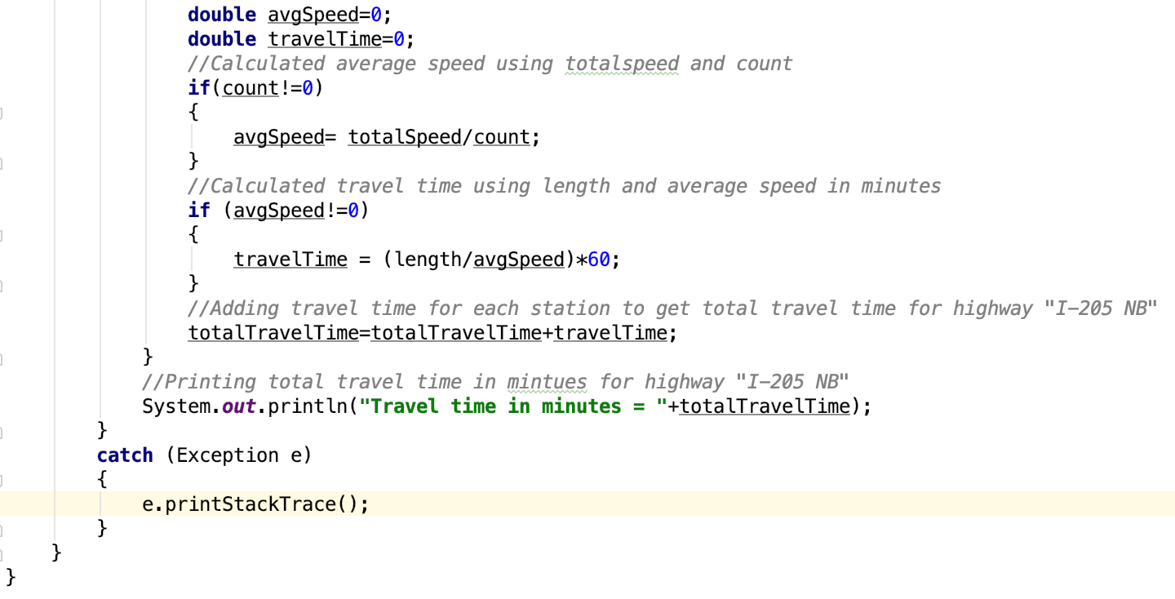

Slide 28
Critique and Lessons Learned

Slide 29
Tried writing queries in noSQL using NoSQL Booster, ran into so many difficulties.
Used java mongoclient driver to connect to mongodb and written and executed queries in java (except the 1st).
For queries 2,3,4,5, initially we tried taking date as String, used regex for pattern searching in the code.
Complicated query, performance issue, also difficult to execute query to calculate speed for 5 minute interval.
Later, we used DATE datatype.
Performance improved a bit, code became less complicated.

Slide 30
Data Cleaning: without data cleaning we had 17.9M documents, that we could have queried with condition dqflag=0 (so that the query only returns uncorrupted data), but cleaning the data reduced it to 13M and improved performance
Implementation phase was different than the planning phase, where we made a lot of changes
During planning, considered only secondary index on detector_id in loopdata collection.
Did not consider any other index, because of the update scenario.
Later added stationid in loopdata and created a compound index on stationid and starttime.
Performance improved drastically
We also realised that since the stations collection had only 17 documents, so indexes on this collection can’t possibly improve the performance by much.

Slide 31
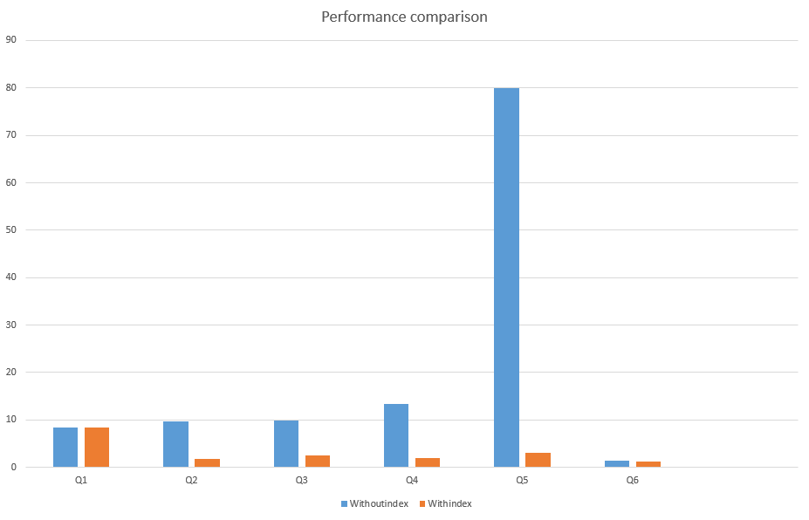
Execution Time stats
Without index: | With index:
8.476 s | 8.438s
9.683 s | 1.842 s
9.875 s | 2.493 s
13.322 s | 2.008 s
80.025 s | 3.088 s
1.318 s | 1.251 s
X: Query run time in seconds Y: Queries

Slide 32
Appendix:

Slide 33
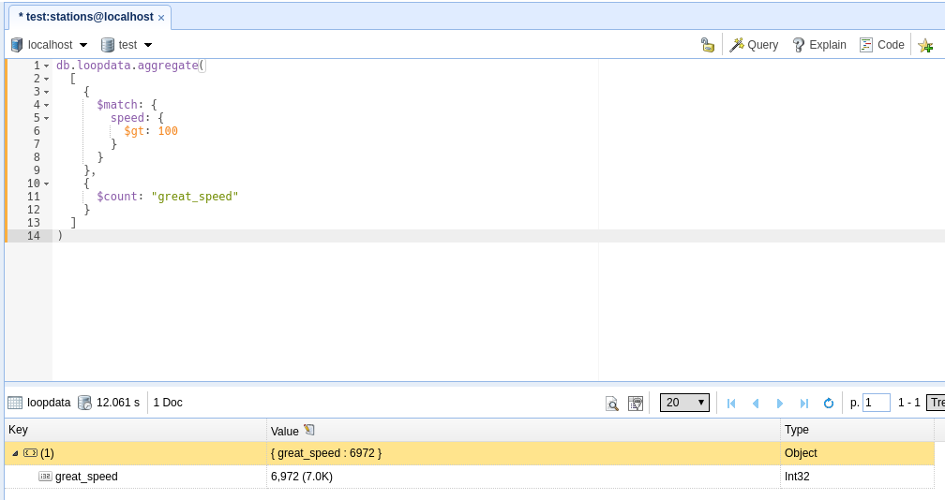
SECTION A - Queries attempted
Query-1: Count high speeds: Find the number of speeds > 100 in the data set

Slide 34
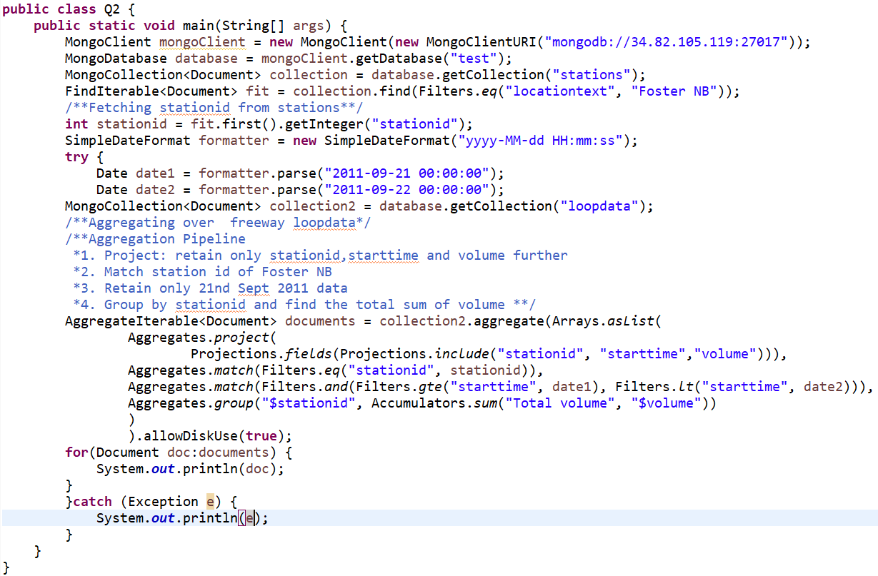
Query - 2: Volume: Find the total volume for the station Foster NB for Sept. 21, 2011.

Slide 35
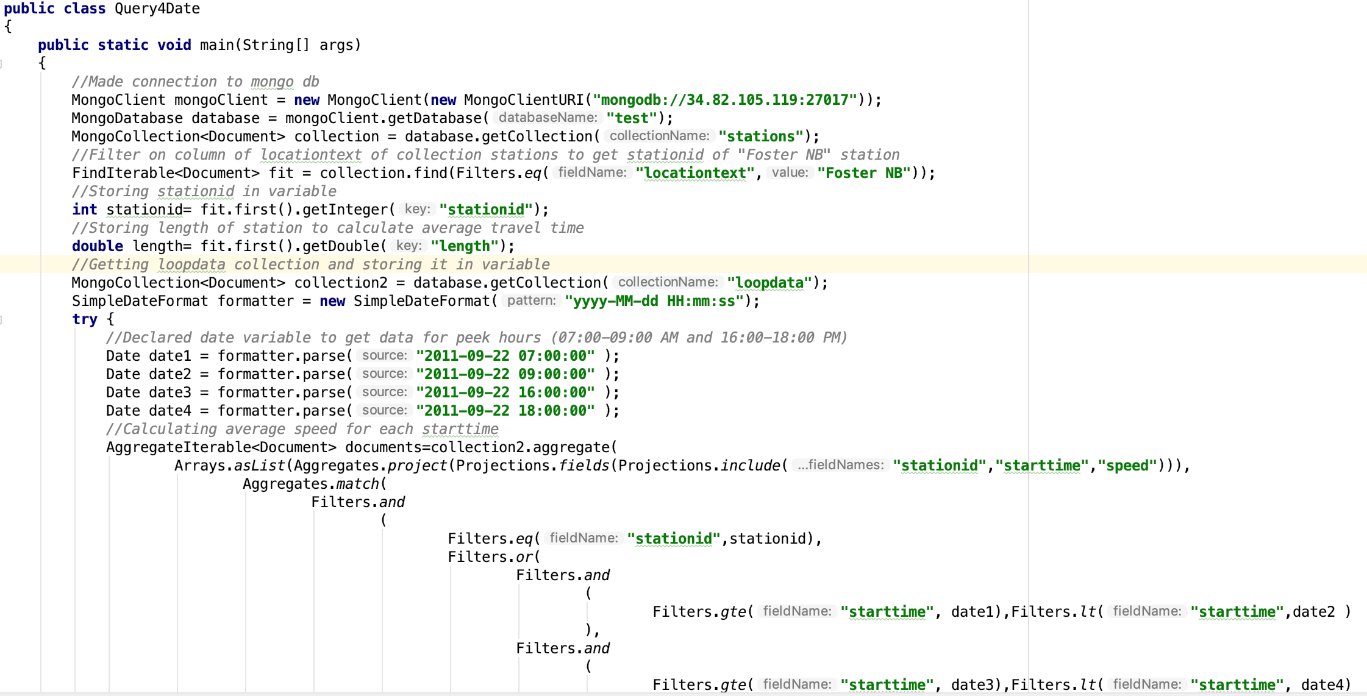
Query - 4 : Peak Period Travel Times: Find the average travel time for 7-9AM and 4-6PM on September 22, 2011 for station Foster NB. Report travel time in seconds.

Slide 36
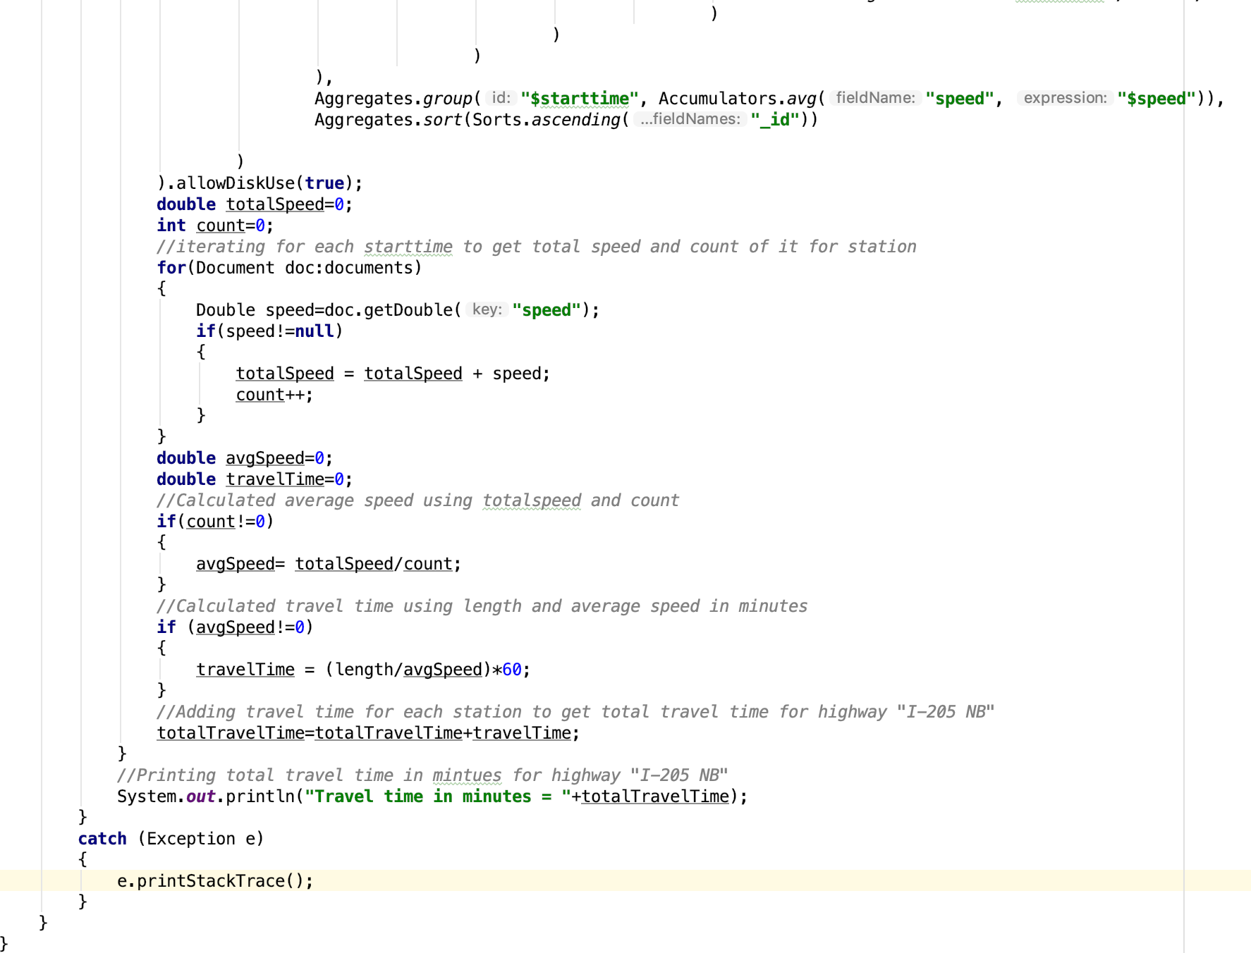

Slide 37
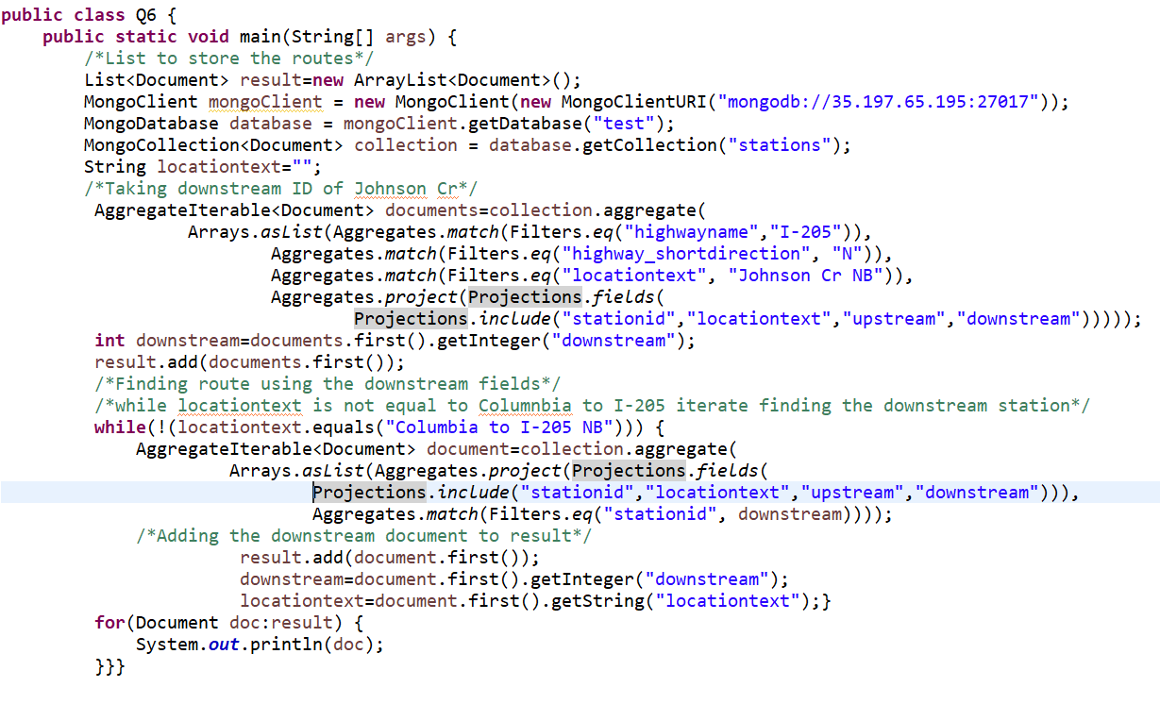
Query - 6: Route Finding: Find a route from Johnson Creek to Columbia Blvd on I-205 NB using the upstream and downstream fields.

Slide 38
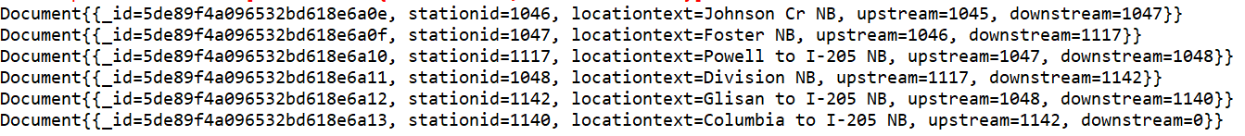
Query - 6: Route Finding: Find a route from Johnson Creek to Columbia Blvd on I-205 NB using the upstream and downstream fields.

Slide 39
SECTION B - Material
https://drive.google.com/drive/folders/1A8DhOPhZ-NMtKyJcrewnzmdSpFRDn_Ry

Slide 40
Thank you! Questions?

